Slide 1

Residual Deep O Net Applied to Molecular Dynamics Simulation of Polymer Diodes
Isaac Smith
Mar 18 2026

Slide 2
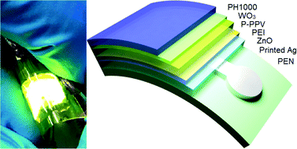
Polymer Diodes
Flexible LEDs
Brain-computer interfaces
Sensing applications
Light
pH
And more..
Zhen et al. 2017. Full-solution processed, flexible, top-emitting polymer light-emitting diodes based on printed Ag electrodes.

Slide 3
Our System
Mobile Anions, Fixed Polycations
-
-
-
-
-
Mobile ions moving in a polyion matrix
We want to model the current as a function of applied electric voltage
-
-
-
-
-
Mobile Cations, Fixed Polyanions
+
+
+
+
+
+
+
+
+
+

Slide 4
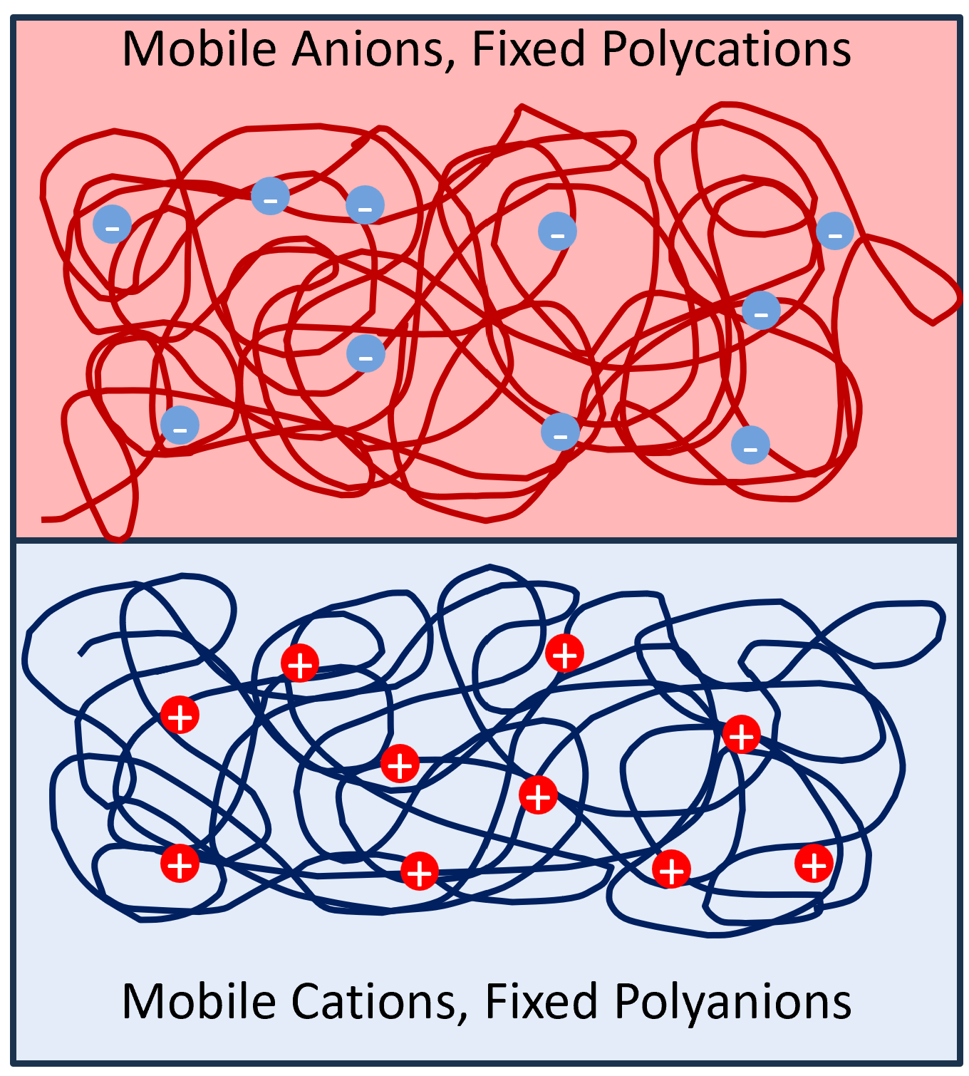
How can we model this system?
Molecular dynamics?
Possible, but expensive
Analytics/Continuum?
Misses excluded volume effects
Analytics are difficult for more complex geometry

Slide 5
How can we model this system?
We want to model current as a function of applied electric field

Slide 6
How can we model this system?
We want to model current as a function of applied electric field

Slide 7

How can we model this system?
We want to model current as a function of applied electric field
Ohm’s law:
But this system is not purely resistive

Slide 8

Residual Neural Operator
Model the difference between true behavior and Ohm’s law:
Use a deep O net for the residual
E(t)
Branch Net
R(t_i)
Dot Product
t_i
Trunk Net

Slide 9
Residual Neural Operator
E(t)
Branch Net (801, 256)->Tanh->(256, 256)->Tanh->(256 256)
R(t_i)
Dot Product
t_i
Trunk Net (1, 64)->Tanh->(64, 64)->Tanh->(64, 256)

Slide 10
Residual Neural Operator
Deep O nets can deal with unequally spaced data
Not a problem for this case, but useful versatility
E(t)
Branch Net
R(t_i)
Dot Product
t_i
Trunk Net

Slide 11
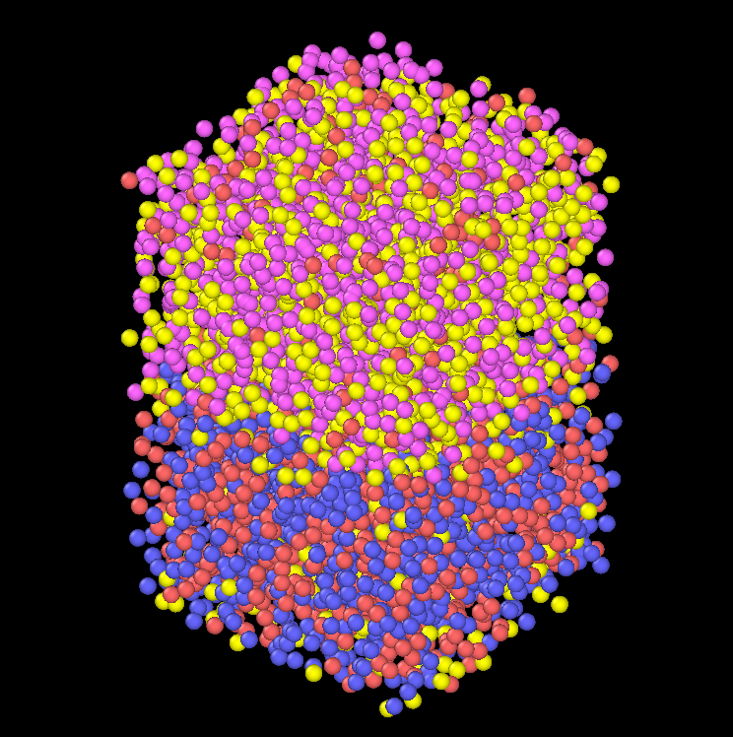
Data Generation
Data generated by molecular dynamics
100 electric field functions with random parameters
Mix of polynomial and sinusoidal components

Slide 12
Molecular Dynamics
Many dimensional ODE integrator
Each particle experiences a force based on the state of the system at that timestep

Slide 13
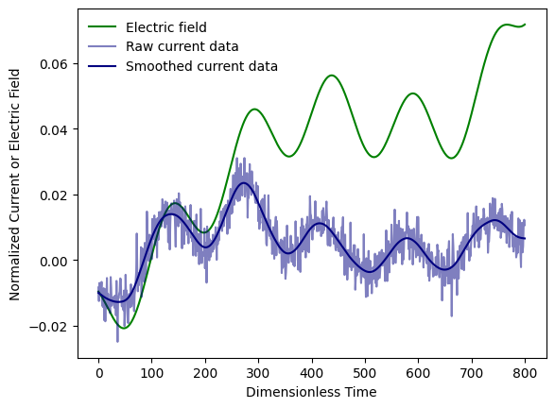
Training
Use spline smoothed data
30000 cycles, each with one randomly chosen point
Decreasing learning rate

Slide 14
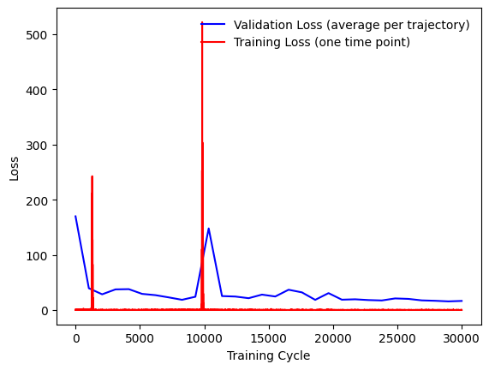
Model Performance
On the test data set:
Mean loss per trajectory: 29.65
Standard Deviation: 11.07

Slide 15
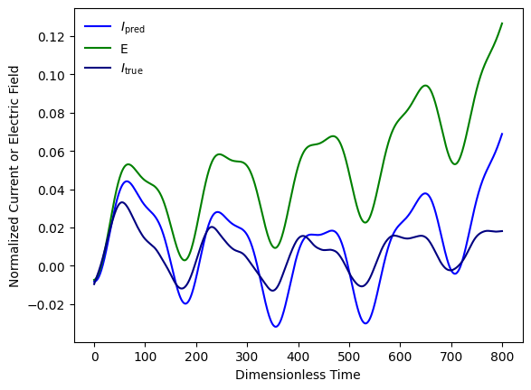
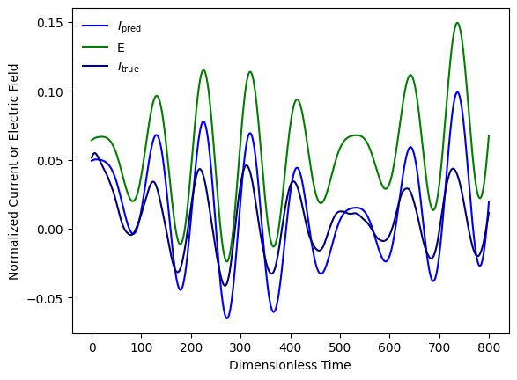
Model Performance

Slide 16
Discussion
Better than Ohm’s law
Spectral bias is a large issue
Different architectures might do better
FNO

Slide 17
Thank you!

